Slide 1
Prof. Dr. Rupprecht Podszun
Platform Services and Competition Law
University of Osnabrück, 19.11.2015

Slide 2
A. Research Question
B. Competition Law Basics
C. Market Definition
D. Competitive Analysis
E. Conclusion

Slide 3
A. Research Question
B. Competition Law Basics
C. Market Definition
D. Competitive Analysis
E. Conclusion

Slide 4
Research Question
Difficulties in handling platforms in competition law?
Need for reform?
Textkörper

Slide 5
Google Case

Slide 6
DG COMP vs Google
Art. 102 TFEU:
The abuse of a dominant position in the market is prohibited.
The Commission’s Case:
Google discriminates against competing shopping services when positioning search results.
Analytical Steps:
Relevant market?
Dominant position?
Abuse?
Remedies?
Notes:
In order to determine whether the undertaking in a dominant position has abused such a position, it is necessary to consider all the circumstances and to investigate whether the practice tends, for example, to bar competitors from access to the market, to apply dissimilar conditions to equivalent transactions with other trading parties, thereby placing them at a competitive disadvantage, or to strengthen the dominant position by distorting competition.
Market definition: it‘s not clear at all which substitutes people would use if google charged a price for their search service.
Aspects to be considered
Market definition → market for general search service?
Low switching costs
Multi-homing possible
Essential facility?

Slide 7
Competition in the Digital Age
Peter Thiel:
Competition on the internet is about building monopolies.
Larry Page:
On the internet, competition is just one click away.
Notes:
In order to determine whether the undertaking in a dominant position has abused such a position, it is necessary to consider all the circumstances and to investigate whether the practice tends, for example, to bar competitors from access to the market, to apply dissimilar conditions to equivalent transactions with other trading parties, thereby placing them at a competitive disadvantage, or to strengthen the dominant position by distorting competition.
Market definition: it‘s not clear at all which substitutes people would use if google charged a price for their search service.
Aspects to be considered
Market definition → market for general search service?
Low switching costs
Multi-homing possible
Essential facility?

Slide 8
A. Research Question
B. Competition Law Basics
C. Market Definition
D. Competitive Analysis
E. Conclusion

Slide 9
Competition
Competition is… an open discovery procedure (Hayek).
Aims of competition law:
protection of the competitive process as such
promoting freedom and welfare
efficiency (optimum factor allocation)
innovation

Slide 10
Pillars of Competition Law
Ban of
Restrictive
Business
Agreements
Art. 101 TFEU
Ban of Abusive Practices by Dominant Companies
Art. 102 TFEU
Merger Control
Merger Control Regulation
Notes:
§ 4 BDSG
(1) Die Erhebung, Verarbeitung und Nutzung personenbezogener Daten sind nur zulässig, soweit dieses Gesetz oder eine andere Rechtsvorschrift dies erlaubt oder anordnet oder der Betroffene eingewilligt hat.
(2) Personenbezogene Daten sind beim Betroffenen zu erheben. Ohne seine Mitwirkung dürfen sie nur erhoben werden, wenn
1. eine Rechtsvorschrift dies vorsieht oder zwingend voraussetzt oder
2.
a) die zu erfüllende Verwaltungsaufgabe ihrer Art nach oder der Geschäftszweck eine Erhebung bei anderen Personen oder Stellen erforderlich macht oder
b) die Erhebung beim Betroffenen einen unverhältnismäßigen Aufwand erfordern würde und keine Anhaltspunkte dafür bestehen, dass überwiegende schutzwürdige Interessen des Betroffenen beeinträchtigt werden.
(3) Werden personenbezogene Daten beim Betroffenen erhoben, so ist er, sofern er nicht bereits auf andere Weise Kenntnis erlangt hat, von der verantwortlichen Stelle über
1. die Identität der verantwortlichen Stelle,
2. die Zweckbestimmungen der Erhebung, Verarbeitung oder Nutzung und
3. die Kategorien von Empfängern nur, soweit der Betroffene nach den Umständen des Einzelfalles nicht mit der Übermittlung an diese rechnen muss,
zu unterrichten. Werden personenbezogene Daten beim Betroffenen aufgrund einer Rechtsvorschrift erhoben, die zur Auskunft verpflichtet, oder ist die Erteilung der Auskunft Voraussetzung für die Gewährung von Rechtsvorteilen, so ist der Betroffene hierauf, sonst auf die Freiwilligkeit seiner Angaben hinzuweisen. Soweit nach den Umständen des Einzelfalles erforderlich oder auf Verlangen, ist er über die Rechtsvorschrift und über die Folgen der Verweigerung von Angaben aufzuklären.

Slide 11
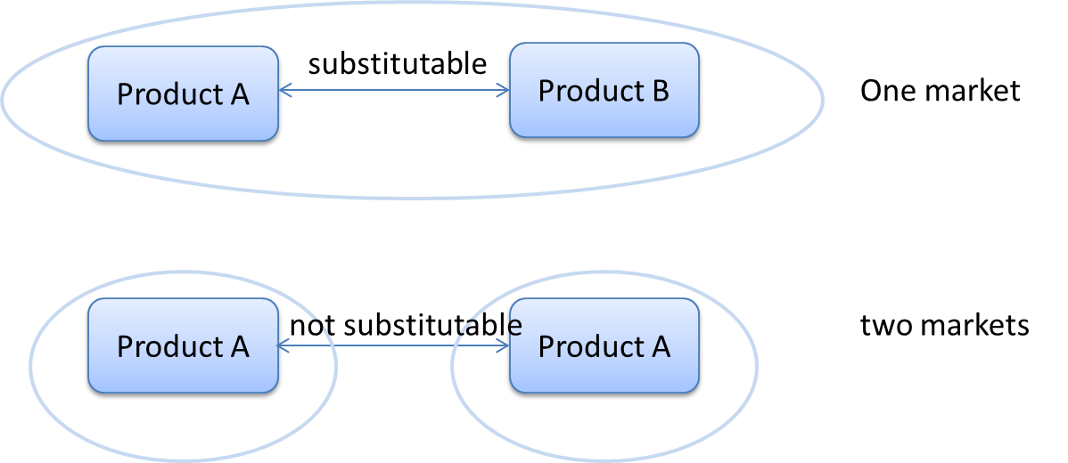
Recurrent Features (1)
Market definition
Notes:
The definition of the relevant market provides the basis for the discussion of the market structure. In practice the SSNIP-Test is the common tool to detect which assets are substitutable.
The question, how much the market is characterized by competition, is relevant for the assessment of agreements under Art. 101 TFEU, for merger controls and for Art. 102 TFEU.

Slide 12
Recurrent Features (2)
Counterfactual analysis of competition
What happens with competition if…?
Substantial indicators:
Market shares
Barriers to market entry
Contestability of markets
…

Slide 13
A. Research Question
B. Competition Law Basics
C. Market Definition
D. Competitive Analysis
E. Conclusion

Slide 14
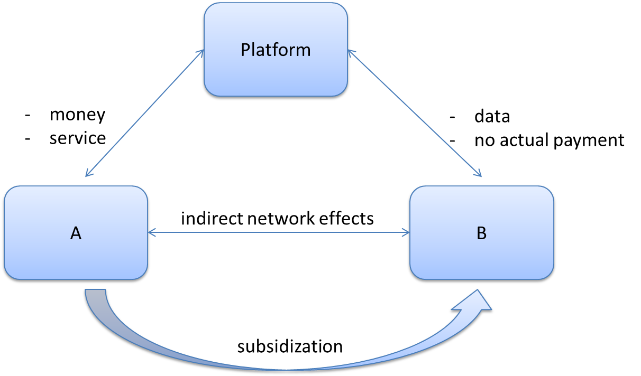
Market Definition
Notes:
Especially digital platforms are free of monetary charge for one user side. This raises the question, whether there is a market relation at all, if users to not pay in a monetary way. The Commission has qualified services without actual payment as relevant markets in recent cases, such as the merger case Facebook/WhatsApp. This broad understanding of a market is correct. Furthermore the user provides data as „payment“ which also contributes to generating more revenue.
To define the relevant market it is crucial to decide whether each side is considered as an own market or both sides as one market. The German FCO considers the possibility of assessing transactional platforms as one product market (Immonet/Immowelt and Verivox/Pro7). However, this does not apply for non-transactional platforms.

Slide 15
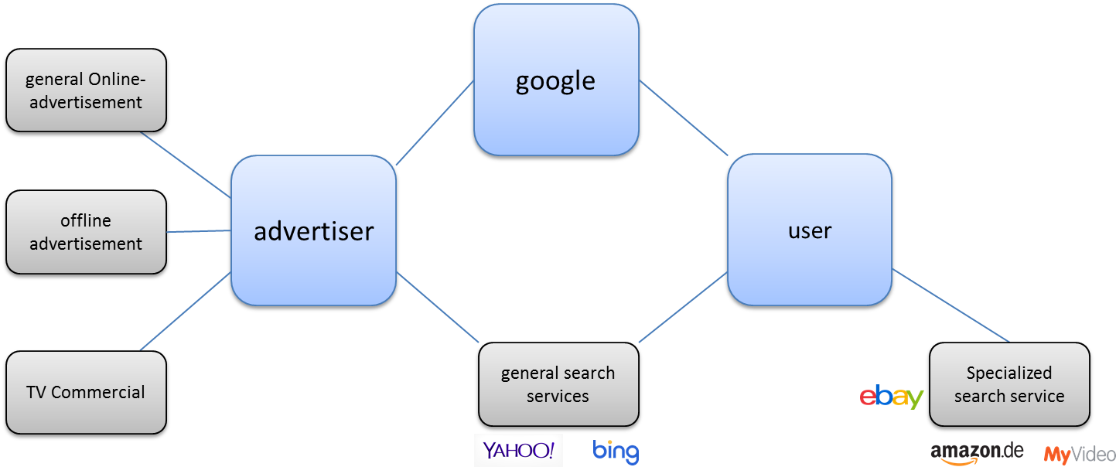
Relevant Market in Google?
Notes:
Defining the relevant market can already be a difficult task dealing with one-sided markets. Market definition regarding two-sided markets is considerably more difficult. The google case is a good example:
In this case the market sides might have to be assessed separately. Users who search for something will use a general search service or – depending on what they are searching for – a special search service. Is there a market for general search services or do users consider special search services as appropriate substitute for google?
Advertisers however might consider different forms of online-advertisement or even TV commercial substitutable. As shown there might be an asymmetry when it comes to market definition.

Slide 16
Tools
Lack of adequate tools for market definition
SSNIP-Test?
Convergence of products/services?
Dynamics of markets?
Changing behaviour of customers?
The problem of free
Notes:
As shown, market definition regarding two-sided markets is very difficult. The question should be whether market definition in platform-cases is as crucial for competition law as in „traditional“ cases.

Slide 17
New Approach?
Refraining from market definition altogether
Pure effects-based analysis
(eg Markovits, Kaplow)
Market definition as full picture of economic circumstances for taking decisions
(Podszun, Antitrust Bull. (forthcoming))
Breaking up the path dependency of market analysis
Notes:
As shown, market definition regarding two-sided markets is very difficult. The question should be whether market definition in platform-cases is as crucial for competition law as in „traditional“ cases.

Slide 18
A. Research Question
B. Competition Law Basics
C. Market Definition
D. Competitive Analysis
E. Conclusion

Slide 19
Traditional Approach
market definition → market shares → market power
counterfactual analysis (prognosis!)
impediment of competition = reduction of consumer welfare
Notes:
Market power means the possibility to raise prices and to exclude other competitors. Market shares usually serve as first filter in the analysis.
On digital platform markets high market shares might serve as an indication for market power to a limited extent only.
In Microsoft/Skype the commission said: Market shares only provide a limited indication of competitive strength in the consumer communications services markets.
In Parship/Elitepartner FCO states: Market shares exceed numbers named in § 18 IV GWB. But significant impediment to competition is not to be expected.

Slide 20
Facebook/WhatsApp
Turnover thresholds?
Relevant markets?
Market shares?
Future developments?
Reduction of consumer welfare?
Commission, 3.10.2014, M.7217:
No close competitors on any of the relevant markets
Notes:
„Consumer communications apps market has been characterised by disruptive innovation. For example, BlackBerry launched the first successful smartphones with integrated consumer communications app and had a very significant market position. However BlackBerry Messenger was available only for BlackBerry smartphones and lost importance with the emergence of multi-platform apps once Android and iOS devices gained a larger part of the smartphone market.“
Low switching costs
BUT maybe following should have been considered:
danger of „big players“ acquiring innovative newcomers?
Access to data as key element in merger control?
→ The participating undertakings did not achieve the turnover thresholds required for the application of the German merger control provisions. There might be new regulatory needs away from turnover threshold.

Slide 21
Issues
Measuring market power: free goods, network effects
Possibility of disruptive innovation
Contestability of markets / switching costs
Relevance of data
Innovation and consumer welfare
Remedy stage: intervention in dynamic markets and complex relationships
The innovation
problem
Notes:
„Consumer communications apps market has been characterised by disruptive innovation. For example, BlackBerry launched the first successful smartphones with integrated consumer communications app and had a very significant market position. However BlackBerry Messenger was available only for BlackBerry smartphones and lost importance with the emergence of multi-platform apps once Android and iOS devices gained a larger part of the smartphone market.“
Low switching costs
BUT maybe following should have been considered:
danger of „big players“ acquiring innovative newcomers?
Access to data as key element in merger control?
→ The participating undertakings did not achieve the turnover thresholds required for the application of the German merger control provisions. There might be new regulatory needs away from turnover threshold.

Slide 22
Case 1: Online-Dating
Bundeskartellamt (Federal Cartel Office), Case B6-57/15, 22.10.2015:
Merger of two online-dating platforms, PARSHIP and ElitePartner
 | Registered members | Monthly visitor numbers | Turnover
PARSHIP | < 5% | 10-15% | 30-35%
ElitePartner | 10-15% | 10-15% | 15-20%
Aggregate | 15-20% | 20-25% | 45-50%
Question of the BKartA: Tipping of the market?
Few barriers to market entry
Multi homing
New-customer business
Free alternatives (e.g. Tinder)
Notes:
Normally market power is determined on the basis of the turnovers of the past year. The FCO, however, took the registered members, monthly visitor number as well as the turnover into consideration. This alternative method was necessary to assess the indirect network effects. Some products, such as Tinder, are free of charge and yet they account for a large part of the market.
Furthermore the amount of registered members is important to evaluate indirect network effects.
Regardless of whether the merging parties have large market shares, the merger has been approved because of these counteractive effects:
No tipping expected
Market entry for innovative newcomers relatively easy
Multi-Homing
Dating-platforms are new customer businesses

Slide 23
Case 2: HRS
Bundeskartellamt (FCO), Case B9-66/10, 20.12.2013:
HRS – Best price clauses
HRS obliges hotels to offer most favoured customer clause to HRS-customers: lowest room price, capacity, booking conditions.
Market: sale of hotel rooms via hotel portals in Germany
Restriction: no incentives left for HRS to offer lower commissions or to adopt new sales strategies; difficulty of market entry; no possibility for hotels to differentiate
Market share HRS: above 30 % (appreciable effect, no exemption via B.E.R.)
No overriding efficiencies
Notes:
FCO: MFN clauses distort competition. The fact that Booking.com and expedia.com use MFN-clauses as well (those three companies have a cumulated market share of 90%) reinforces this issue. New innovative service providers are not able to enter the market by offering especially favourable conditions. (In Case AT.39847 – E-books the Commission has also pointed out, that MFN-clauses restrict competition – this was not a case regarding digital platforms)
For innovative newcomers like JustBook Mobile GmbH (a hotel booking-app that provided users who booked hotel rooms after 12 o‘clock a significant discount) it was not possible to enter the market by providing incentives for the customer‘s, such as offering hotel rooms at good conditions, because HRS would always be able to offer the same price.
The FCO examined the possibility of an individual exemption under Art. 101 III TFEU. HRS claimed that MFN-clauses increase welfare by preventing free-riding. The clauses would hedge investments and thus lead to high quality of the service. However, the FCO did not consider this as a significant tool to enhance welfare.
HRS claims that the FCO‘s decision lead to the recent downturn of HRS. (http://www.wiwo.de/unternehmen/dienstleister/hotel-buchungen-wie-hrs-die-globalisierung-verschlafen-hat/12392622.html)

Slide 24
Case 3: Google
Watch what happens, but:
The more compelling case is the Android case!
Notes:
In order to determine whether the undertaking in a dominant position has abused such a position, it is necessary to consider all the circumstances and to investigate whether the practice tends, for example, to bar competitors from access to the market, to apply dissimilar conditions to equivalent transactions with other trading parties, thereby placing them at a competitive disadvantage, or to strengthen the dominant position by distorting competition.
Market definition: it‘s not clear at all which substitutes people would use if google charged a price for their search service.
Aspects to be considered
Market definition → market for general search service?
Low switching costs
Multi-homing possible
Essential facility?

Slide 25
A. Research Question
B. Competition Law Basics
C. Market Definition
D. Competitive Analysis
E. Conclusion

Slide 26
Deficits
Issues identified as problematic relate to
the problem of free (and data)
the innovation problem
bias of competition law in favour of static efficiencies
Notes:
Innovation is key element
Market definition only as rough approximation
Consideration of data and services without actual payment
The high degree of abstraction of the European competition law makes it possible to adapt to new economical and technological findings!

Slide 27
Need for action?
Consideration of dynamic efficiencies as much as allocative and productive efficiencies
No static rules for a dynamic digital economy
More technological approach
Notes:
Innovation is key element
Market definition only as rough approximation
Consideration of data and services without actual payment
The high degree of abstraction of the European competition law makes it possible to adapt to new economical and technological findings!

Slide 28
Example 1: Market Power
Are customers able to switch if there is a
small but significant decrease in quality (SSDQ-test)?
Parship/ElitePartner: yes
HRS: no
Google search: contested
Notes:
Innovation is key element
Market definition only as rough approximation
Consideration of data and services without actual payment
The high degree of abstraction of the European competition law makes it possible to adapt to new economical and technological findings!

Slide 29
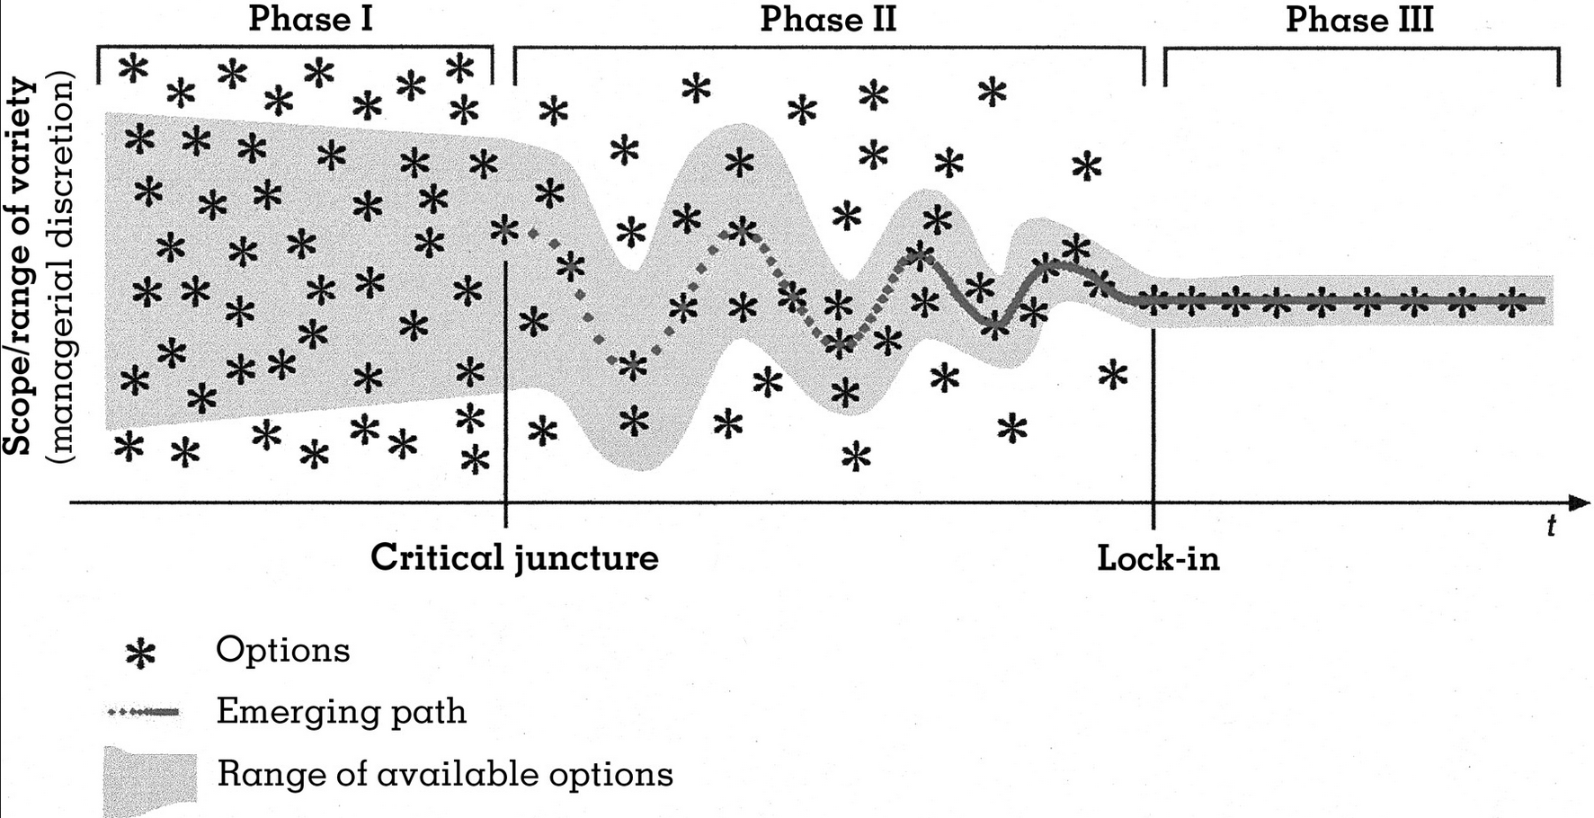
Example 2: Consumer Harm
Does the conduct lead to path dependencies and a technological or factual lock-in?
Parship/ElitePartner: yes
HRS: no
Google search: contested
Notes:
Innovation is key element
Market definition only as rough approximation
Consideration of data and services without actual payment
The high degree of abstraction of the European competition law makes it possible to adapt to new economical and technological findings!

Slide 30
Thank you!
LS-podszun (at) uni-bayreuth.de

Slide 31
Infringement of Article 102 TFEU?
Allegation:
Android is used as tying product to force google apps on mobile phone manufacturers. These manufacturers cannot decide to exclude some google apps before being shipped to customers.
Notes:
Android is a software platform that brings together developers and users. It allows independet firms like apps developers to introduce innovations into an established environment.

Slide 32
Contractual restrictions
FCO case report B6-46/12, 26.11.2013 – Amazon Marketplace – price parity clause
The price parity clause in the contracts concluded between Amazon and retailers who use Amazon Marketplace obliged retailers to always offer their lowest price on Amazon Marketplace.
Amazon abandoned clause from contracts!
Notes:
The FCO came to the conclusion that the marketplace is a horizontal cooperation which may affect trade between Member States and which has as their object or effect the prevention, restriction or distortion of competition within the internal market. Price parity clauses do not contribute to improving the production or distribution of goods or to promoting technical or economic progress, while allowing consumers a fair share of the resulting benefit.
Price parity create entry barriers. The most relevant parameter of competition – the fees paid for the platform service – are neutralized by price parity clauses because low fees cannot be passed on to customers.

Slide 33
Analysis
Competition law should prevent: counteractive effects
lock-in effects and path dependencies
reaching critical mass
→ danger of „tipping“
dynamic character of the market (disruptive innovations)
multi-homing
switching costs (often insignificant)
possibility of market entry
new customer businesses
Notes:
Examples for the dynamic character of many markets: Blackberry Messenger → WhatsApp
MySpace → Facebook → Instagram?
yahoo → google

Slide 34
Access to data as key element?
→ Network effects
→ Data portability
Path dependency/ Switching costs
→ Essential facility (google?)
Notes:
Thus far access to data has not been a factor. Should there be a change?
Majority opinion: Competition law should not be used for data protection
Several suggestions (especially regarding google):
Google should be required to share its specific search engine data to foster competition in search engine markets. → competitors could use this information to develop a better search algorithm → Problem: data protection!
Mandate google to colour the background of links to its own subsidiaries in a similar manner as sponsored links. → increased transparency → consumers can evaluate the quality of the results and, in case they are not satisfied, can switch to other search services.
No intervention at all! Process of creative destruction by innovative and disruptive technologies!

